Slide 1
Course 2 Module 5 Programming Assignment Assignment is to ETL MIMIC data into the OMOP CONDITION_OCCURRENCE table
Detailed instructions with Slide Notes

Slide 2
ETL Steps
Assignment is to ETL MIMIC data into the OMOP CONDITION_OCCURRENCE table
Understand source/target data models
Profile source tables
Create ETL mappings
Write transformation code
Execute transformation
Perform data quality assessment
Package documentation
Notes:
This is an overview of the seven steps for ETL. The assignment focuses on Steps 1 thru 4 and Step 6
Place your finished deliverables into one or more slides. Add notes to provide additional information/context about what you have done

Slide 3
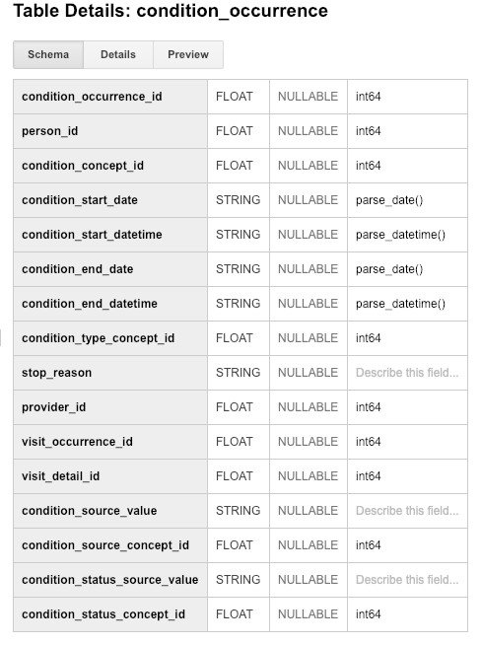
Step 1: Understand source/target data models
CONDITION_OCCURRENCE is the TARGET OMOP table.
Read the OMOP documentation about the type of data stored in CONDITION_OCCURRENCE and for three fields below that are in that table:
person_id
visit_occurrence_id
condition_source_value
Notes:
Paste into one or more slides, the key table or tables from MIMIC that hold data that can be used to fill in the OMOP CONDITION_OCCURRENCE table.
Choose the MIMIC table screenshots from this slide to indicate which MIMIC table or tables would be used in the ETL process. Delete the MIMIC tables that you will not use.

Slide 4
Step 1: Understand source/target data models
CONDITION_OCCURRENCE is the TARGET OMOP table.
Select one or more MIMIC tables from the table screen shots on the next slides that you feel are most related to the three fields in CONDITION_OCCURRENCE.
Notes:
Paste into one or more slides, the key table or tables from MIMIC that hold data that can be used to fill in the OMOP CONDITION_OCCURRENCE table.
Choose the MIMIC table screenshots from this slide to indicate which MIMIC table or tables would be used in the ETL process. Delete the MIMIC tables that you will not use.

Slide 5
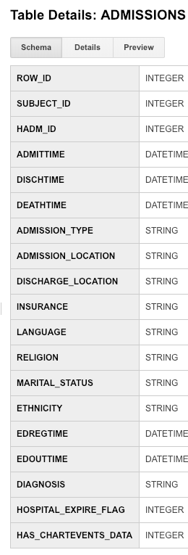
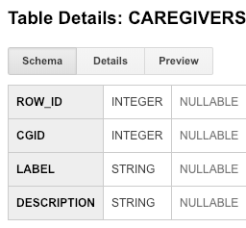
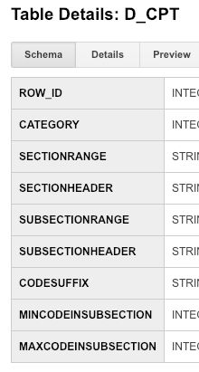
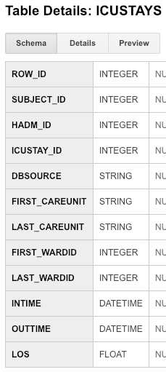
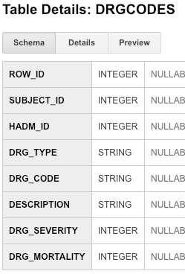
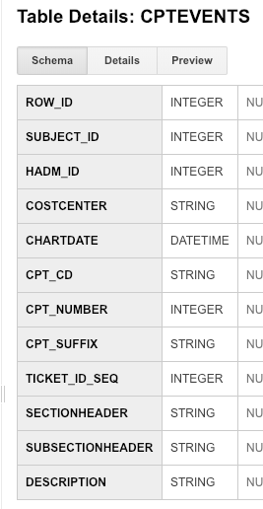
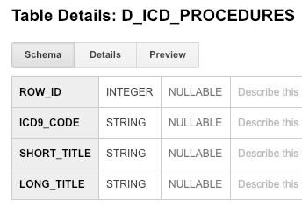
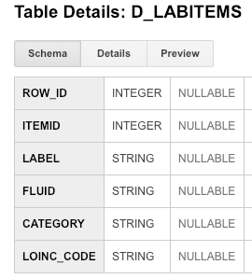
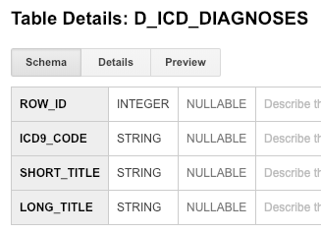
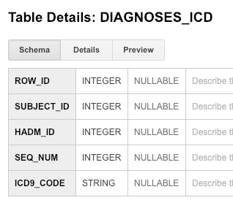
Use these screen captures (and next slide) to select one or more MIMIC tables that contain data for OMOP CONDITION_OCCURRENCE table
Notes:
Paste into one or more slides, the key table or tables from MIMIC that hold data that can be used to fill in the OMOP CONDITION_OCCURRENCE table.
Choose the MIMIC table screenshots from this slide to indicate which MIMIC table or tables would be used in the ETL process. Delete the MIMIC tables that you will not use.

Slide 6
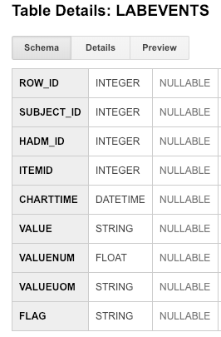
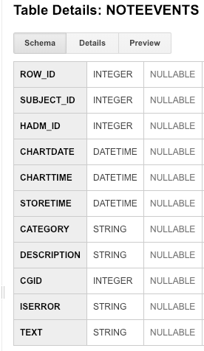
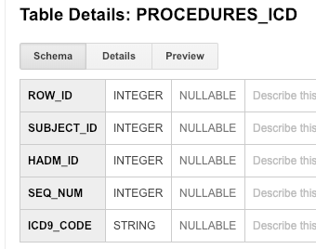
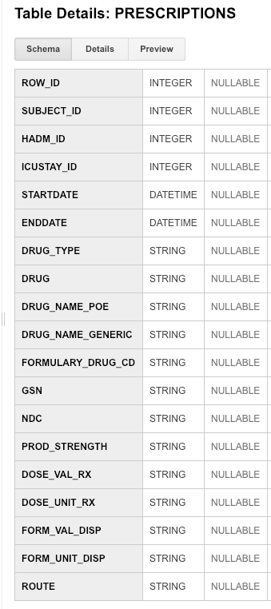
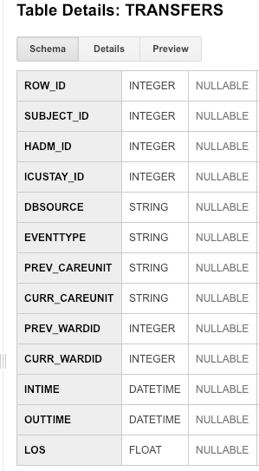
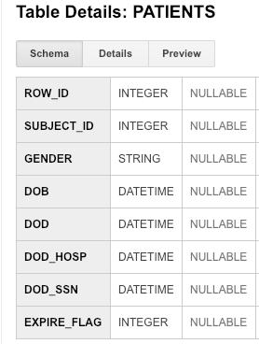
Use these screen captures (and previous slide) to select one or more MIMIC tables that contain data for OMOP CONDITION_OCCURRENCE table
Notes:
Paste into one or more slides, the key table or tables from MIMIC that hold data that can be used to fill in the OMOP CONDITION_OCCURRENCE table.
Choose the MIMIC table screenshots from this slide to indicate which MIMIC table or tables would be used in the ETL process. Delete the MIMIC tables that you will not use.

Slide 7
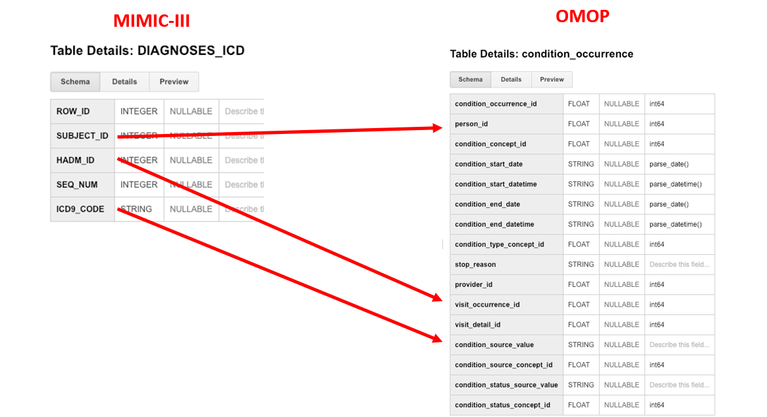
Step 1: Understand source/target data models
Notes:
Paste into one or more slides, the key table or tables from MIMIC that hold data that can be used to fill in the OMOP CONDITION_OCCURRENCE table.
Choose the MIMIC table screenshots from this slide to indicate which MIMIC table or tables would be used in the ETL process. Delete the MIMIC tables that you will not use.

Slide 8
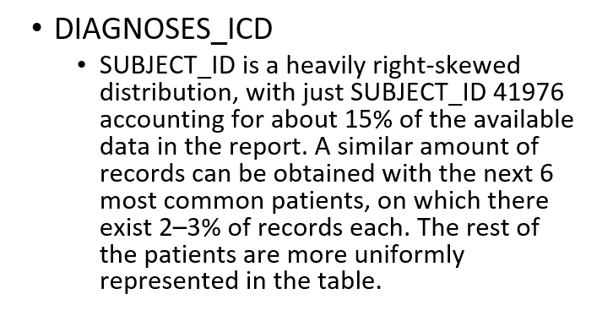
Step 2: Profile source table or tables
Using the White Rabbit profiling data from the 100 patient MIMIC database provided in the Assessment to comment on the distribution of the SUBJECT_ID field from one of the MIMIC tables selected in Step 1
Notes:
Use the White Rabbit data profiling Excel spreadsheet that is linked to the assignment to describe key profiling findings from the table or tables you identified in ETL Step 1. See rubric for the types of topics to include here.

Slide 9
Step 3: Create ETL mappings
MIMIC TableName
Field 1
Field 2
Field 3
Field 4
Field 5
Field 6
Field 7
Field 8
The mapping is as follows:
The subject_id from the ADMISSIONS table in MIMIC is mapped to the person_id field in the CONDITION_OCCURRENCE table in OMOP.
The hadm_id from the ADMISSIONS table in MIMIC is mapped to the visit_occurrence_id field in the CONDITION_OCCURRENCE table in OMOP.
The icd9_code from the DIAGNOSES_ICD in MIMIC is mapped to the condition_source_value in the CONDITION_OCCURRENCE table in OMOP.
Notes:
For each MIMIC table or tables (one table per slide) from Step 1, paste the screenshot of the MIMIC table on left side. Show field mappings from the MIMIC table to the OMOP CONDITION_OCCURRENCE table using arrows. Only provide mappings to the OMOP person_id, visit_occurrence_id, and condition_source_value. One MIMIC table may provide a mapping to all three OMOP tables as shown here.
Provide an explanation for each mapping why the MIMIC field relates to the OMOP field you selected on the slide

Slide 10
Step 4: Write transformation code
WITH CONDITION_OCCURRENCE1 as (select adm.subject_id as person_id, adm.hadm_id as visit_occurrence_id
from mimic3_demo.ADMISSIONS adm),
CONDITION_OCCURRENCE as (select oc1.person_id, oc1.visit_occurrence_id, diag.icd9_code as condition_source_value
from CONDITION_OCCURRENCE1 as oc1
join mimic3_demo.DIAGNOSES_ICD as diag
on oc1.visit_occurrence_id = diag.hadm_id)
select * from CONDITION_OCCURRENCE as oc
order by oc.person_id, oc.visit_occurrence_id;
Paste the SQL statements that transform data from one or more MIMIC tables into the three OMOP CONDITION_OCCURRENCE fields (patient-id, visit_occurrence_id, condition_source_value) into the Coursera Submission Site
Transformation code shown here is from the Course 2 videos showing transformation of MIMIC PATIENTS to OMOP PERSON
Notes:
Paste the SQL statements that transform data in one or more MIMIC tables to the correct column or columns in OMOP CONDITION_OCCURRENCE into the Coursera Submission Site.

Slide 11
Step 5: Execute transformation code
Execute the ETL code from Step 4 but do not submit the output table.
Use the output table for Step 6.
There is no submission for this Step.
Notes:
Execute the ETL code from Step 4 but do not submit output table. Use output table for Step 6.
There is no submission for this Step.

Slide 12
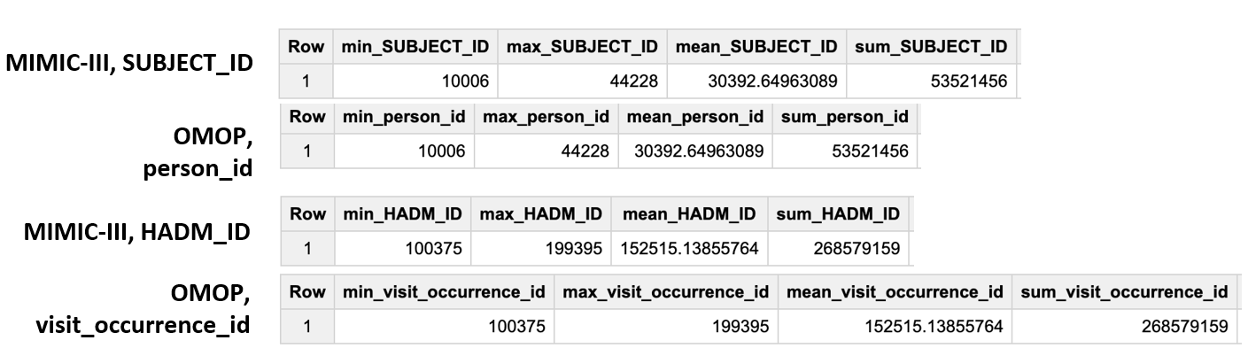
Step 6: Perform data quality assessment
Define, implement, execute one or more data quality measures.
Submit final DQ measure and an explanation why you created your measure(s).
Notes:
Paste the output from your data quality SQL executed on the OMOP CONDITION_OCCURRENCE table generated in Step 5 into this slide.
OK to paste link to a GoogleDoc instead.

Slide 13
Step 7: Package documentation
Congratulations! The materials in the previous slides constitute a complete ETL package.
There is no submission for this Step.

